Slide 1
OPINION MINING: CUSTOMER REVIEWS CSC 869 Data Mining
By:
Harsh Vardhan Shrivastava
Nilaykumar Patel
Meenal Honap

Slide 2
Outline
Project Topic & Problem Description
Introduction to Opinion Mining
Project Requirements and Specification
KDD process.
Data Preprocessing
Data Warehousing and finding task relevant data
Data Mining Algorithms
Summarization
Limitations and shortcomings
Individual Contribution
Conclusion

Slide 3
Project Topic and Problem Description
Text Data: Customer Reviews
Tasks
Opinion mining: Positive , Negative or Neutral
Classification: Naïve Bayes, Check Polarity
Summarization
Data
Contain sentences extracted from user reviews on 51 different topics.
We focused on
Garmin GPS
Amazon Kindle
Hotel near SFO
Opinosis Opinion ⁄ Review Data Set
http://archive.ics.uci.edu/ml/datasets/Opinosis+Opinion+%26frasl%3B+Review

Slide 4
Introduction to Opinion Mining
Opinions are expressions that describes people’s sentiments towards an entity.
People usually rely on peer reviews than product specification.
Organizations depend on surveys, opinion polls for their product reviews.
Availability and easy access of internet facilitates online posting of opinions and reviews.
Notes:
Removed ‘Subjective’ from here.

Slide 5
Project Requirement and Specs
Feature Selection
POS tagging – use of POS tagger
Classify data
Naïve Bayesian Algorithm
Check Polarity Algorithm
Summarization
Evaluation and Error detection

Slide 6
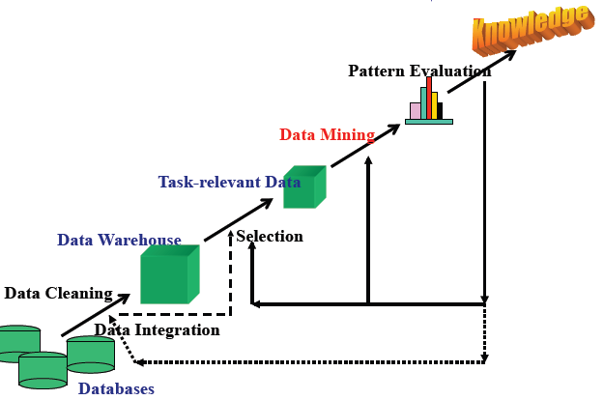
KDD Process

Slide 7
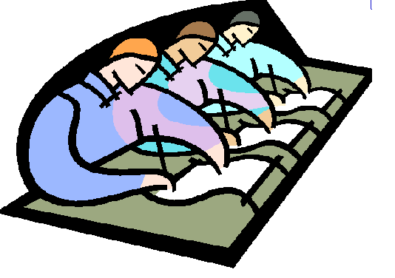
Data Preprocessing

Slide 8
Data Preprocessing…
Manual Feature Selection
E.g Battery is good.
Feature : battery
POS Tagging
Using Stanford Parser.
E.g Battery is good
Battery/NNP is/VBZ good/JJ

Slide 9

Data Mining…..

Slide 10
Naïve Bayesian Classifier Implementation
Preprocessing
Tag each word in the sentences using POS Tagger.
Collect Adjectives, Adverbs, Context Shifters and Negation words
Attach the gold standard label.
Divide the data into training set and test set.
Naïve Bayes
From test set, compare each attribute with corresponding attributes in training set.
Check the corresponding label.
Keep the count of corresponding labels to count probability.
Finally multiply the probabilities for each classifier and label the test set tuple with highest probability classifier.

Slide 11
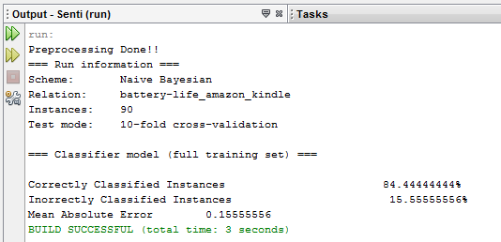
Continued..
K-fold Cross Validation
Repeat the above process for ‘k=10’.
Randomize the tuple positions in data set each time to choose new training and test set tuples.
Accuracy is measured over these k iterations to get the final results.

Slide 12
Check Polarity Algorithm [6]
Tag each word in the sentences using POS Tagger.
Collect Noun, Noun Phrases, Adverbs and Adjectives
Nouns - Product features. Compare with general inquirer noun set (finding features).
If feature word is found, extract adjective from position (X+5 to X-5) and consider it as opinion word.
Now calculate its word semantic orientation by assigning semantic weight to it.

Slide 13
Continued…
If there are Negative words in N+3 and N-3, reverse its polarity
Find Context Shifter words in the sentences and calculate its weight (But, expect, however, only, although, though, while, whereas)
Contradictory nature contact shifter (Although, Despite, While)
Mobilizing or modal contact shifter (Would, Should)
Pre-Supposition contact shifter (Miss, forget, refused, assumed, hard, harder, les
Checks the modifier word in the sentence e.g. Slightly, Somewhat, Pretty, Really, Very, Extremely, (the) most, if find the word then recalculate the polarity referring the weightage dictionary.

Slide 14

Summarization…

Slide 15
Summarization
Customer reviews on the web can be in hundreds or thousands
Difficult for customer – cannot read all the reviews
Difficult for manufacturer – cannot keep a track of all reviews
Manufacturer produces many products
Summarization solves the problem

Slide 16
Summarization
Product Summarization
Compute a count to show the number of positive and negative sentences
Feature Based Summarization
For every feature, compute a count to show number of positive and negative sentences
E.g.: Feature : battery
Total Positive : 12
Total Negative : 5
Conclusion: Battery is good.

Slide 17
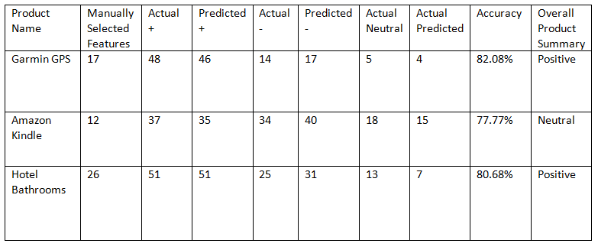
Summarization Chart
Notes:
Delete this slide since we have confusion Matrix

Slide 18
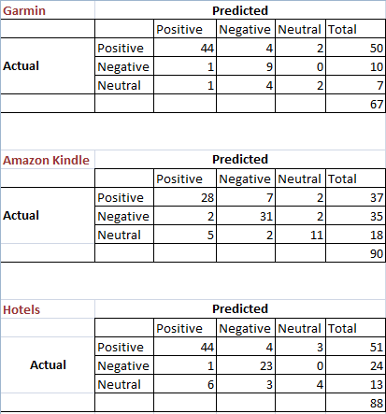
Error Detection and Confusion Matrix

Slide 19
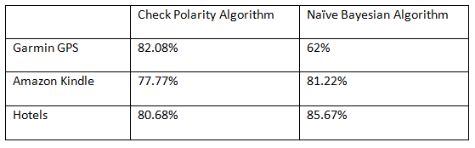
Accuracy Table

Slide 20
Limitations and shortcomings
Limitation of Check Polarity Algorithm
Modifiers of certain Nouns Curtains nouns like (A(little)bit of (a), A few, Minor, Some, A lot,Deep, Great, A ton of) effect the sentence polarity, so recalculate the polarity if such type of word occur.
Cannot detect certain kind of reviews
Eg: For a movie review:
Go and find out for yourself!
The Algorithm cannot detect whether the above review is positive or negative

Slide 21
Individual Contributions
Common Tasks
Literature Survey
Manual Feature Selection
Setting Gold Standards
Inter Annotator Agreement
Evaluation and Error Detection
Documentation
Harsh Vardhan Shrivastava
Data Preprocessing
POS Tagging
Synonyms
Nilaykumar Patel
Data Mining
Design of Algorithms
Implementation of Check Polarity Algorithm and Naïve Bayesian Classifier
Meenal Honap
Data Postprocessing
Design of Algorithm
Feature Summarization

Slide 22
Conclusion
We proposed a technique for mining and summarizing reviews based on NLP and Data mining techniques.
Results indicate that our approach is promising.
Accuracy can be improved by determining strength of opinions.
“New Words” pose a challenge

Slide 23
References
[1] Kavita Ganeshan, ChengXiang Zhai and Jiawei Han.”Opinosis : A Graph- Based Approach to Abstractive Summarization of Highly Redundant Opinions”
[2] Kim, H. D., K. A. Ganesan, P. Sondhi, and C. X. Zhai, A Comprehensive Survey Of Opinion Summarization, : University of Illinois at Urbana-Champaign, 2010.
[3] Ganesan, K. A., and H. D. Kim, Opinion Mining - A Short Tutorial (Talk), , University of Illinois at Urbana Champaign, 2008.
[4] Bing Liu, “Sentiment Analysis: A Multi-Faceted Problem” To appear in IEEE Intelligent Systems, 2010.
[5] SentiWord, http://sentiwordnet.isti.cnr.it/
[6] Aurangzeb Khan, Bharum Baharudin, Khairullah Khan, “Sentence Based Sentiment Classification from Online Customer Reviews”, 2010.
[7] WordNet, http://wordnet.princeton.edu/wordnet/download/

Slide 24

Questions and Suggestions…

Slide 25


